Slide 1

Linear Transformations & Quadratic Forms of Matrix
SE Sem IV- 2024-25
Guide
Prof. Madhavi Mali
Department Of Computer Engineering
Watumull Institute Of Engineering And Technology

Slide 2

Group Members:
Sakshi S. Patil (Roll No:82)
Saukhya Patil (Roll No:83)
Vedanti Patil (Roll No:84)
Vishakha Patil (Roll No:85)
Ankita Pawar (Roll No:86)
Shubham Pawar (Roll No:87)
Github Link

Slide 3
Introduction
Linear transformations and quadratic forms are the concepts in linear algebra, both are fundamentally connected to matrices.
A linear transformation is a function between vector spaces that preserves vector addition and scalar multiplication, and it can be represented by a matrix.
Quadratic forms are special kinds of homogeneous polynomials of degree two in several variables, and they are deeply linked to symmetric matrices.

Slide 4
Challenges & Limitations
Complexity: Large matrices require efficient algorithms to compute transformations and quadratic forms (e.g., eigenvalues).
Non-linear extensions: Transforming quadratic relationships into linear ones can introduce errors.
Approximation limits: Quantum computing implementations of quadratic forms face precision issues with parameterized values.
Matrix Symmetry: Quadratic forms require symmetric matrices, asymmetric matrices complicates the computations.

Slide 5
Importance & Applications in different fields
Fields | Application
AI & Data Science | Dimensionality reduction PCA, kernel methods in SVM.
Engineering & Technology | Stress-strain analysis, control systems.
Economics | Optimization of utility functions, quadratic cost models.
Medicine & Healthcare | Medical imaging (MRI/CT scans) via linear operators.
Aerospace & Defense | Flight dynamics modeling with rotation/translation matrices.

Slide 6
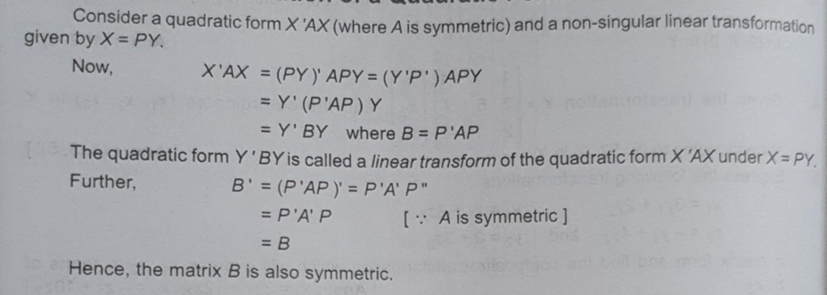
Concepts & Explanations

Slide 7
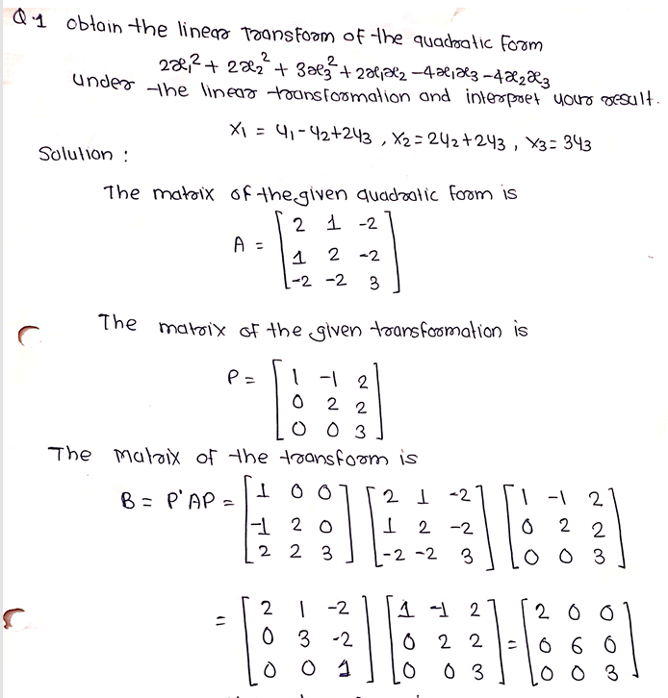
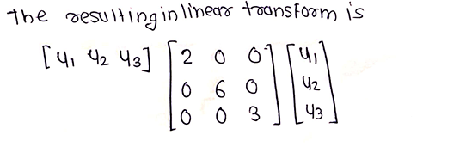
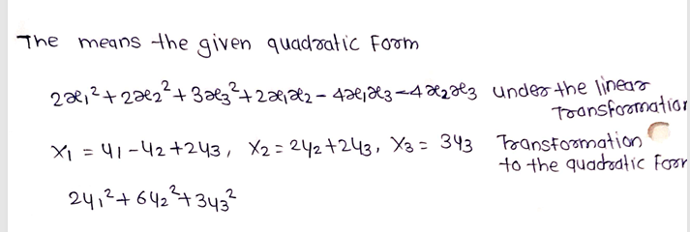
Example

Slide 8
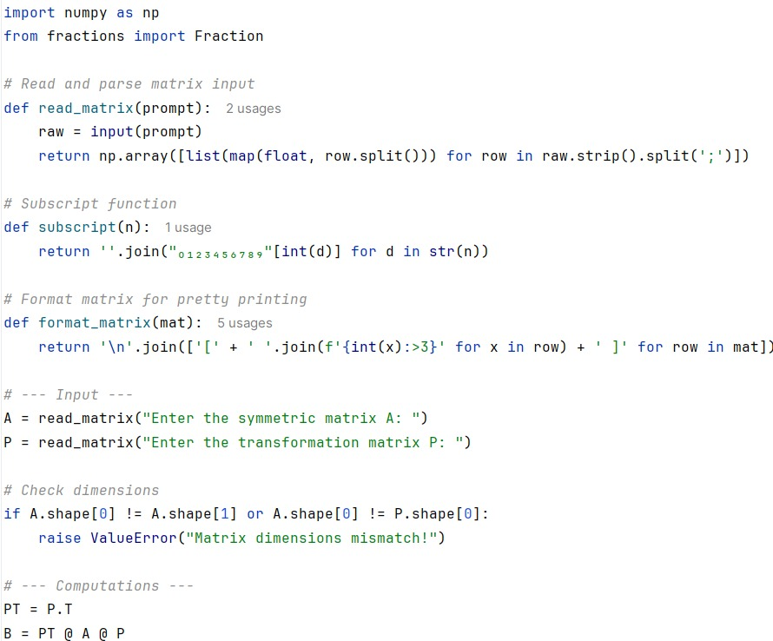
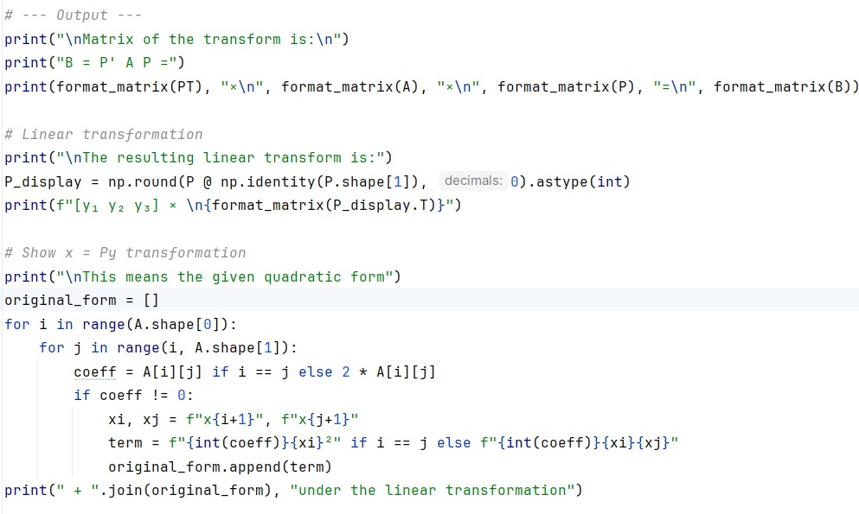
Demonstration

Slide 9
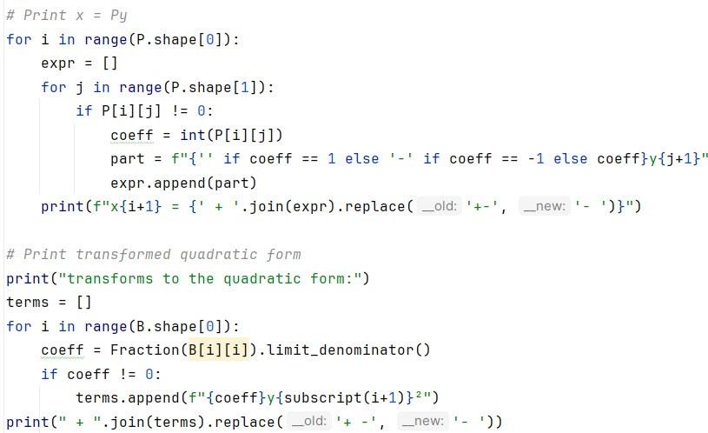
Demonstration

Slide 10
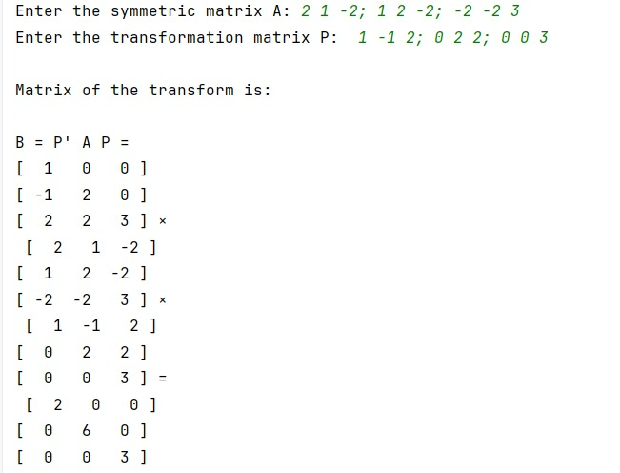
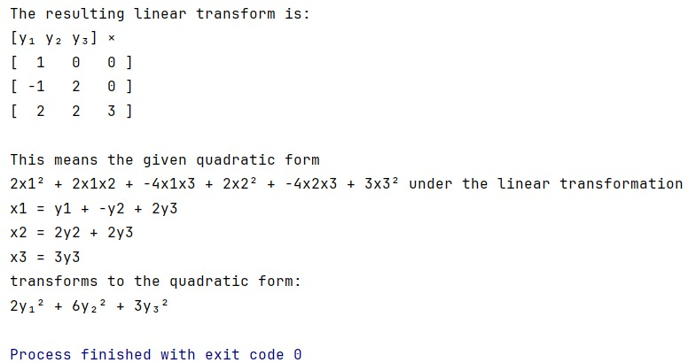
Demonstration

Slide 11
Conclusion
Quadratic forms can be simplified using linear (matrix) transformations.
The transformation B=PTAPB = P^T A PB=PTAP reduces the quadratic form to canonical (diagonal) form.
It allows for easier analysis and interpretation in various fields (e.g., optimization, graphics, ML).
The process transforms the original variables into new coordinates that eliminate cross-product terms.
Overall, it’s a powerful method to understand and work with multivariable quadratic expressions.

Slide 12
References
Perplexity AI.
Chat Gpt.
Engineering Mathematics –IV (G. V. Kumbhojkar)

